Slide 1

Comprehensive Analysis and Forecasting of Air Quality in Kathmandu
This presentation explores the application of data science techniques to analyze and forecast air quality in Kathmandu, Nepal, a city facing significant air pollution challenges.
Presented by Sangam Poudel, Saroj Rawal, and Subesh Yadav.

Slide 2
Understanding the Problem
Rapid Urbanization
Valley Geography
Kathmandu's rapid population growth and development have led to increased vehicular traffic, industrial activities, and construction projects, contributing to air pollution.
The city's valley geography, surrounded by hills, restricts air circulation, trapping pollutants and exacerbating air quality issues.

Slide 3

The Impact of Air Pollution
Health Risks
Environmental Degradation
Air pollution contributes to respiratory diseases, cardiovascular problems, and other health complications, particularly affecting vulnerable populations.
Pollutants impact ecosystems, reduce visibility, and contribute to climate change, affecting the overall environment and quality of life.

Slide 4
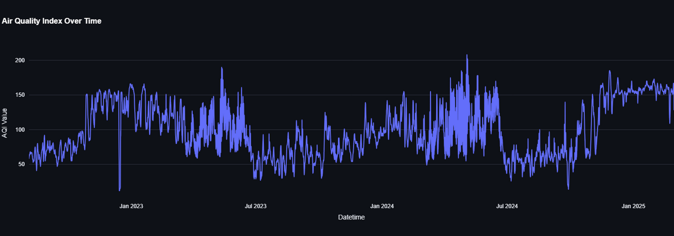
Data-Driven Solutions
Data Collection
Data Analysis
Predictive Modeling
We collected the historical weather data from the Open-Meteo website, which provides reliable and accessible meteorological information.
Utilizing exploratory data analysis (EDA) to identify patterns, trends, and correlations between air quality parameters and meteorological factors.
Developing forecasting models using time-series and machine learning techniques to predict future air quality levels.

Slide 5
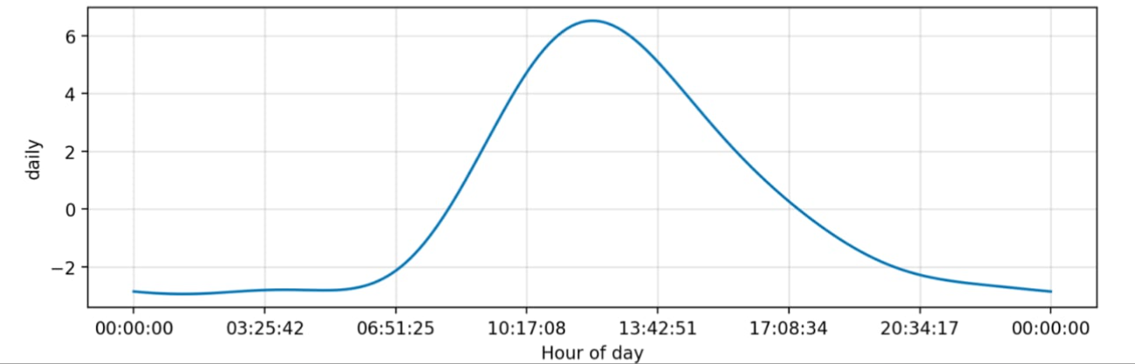
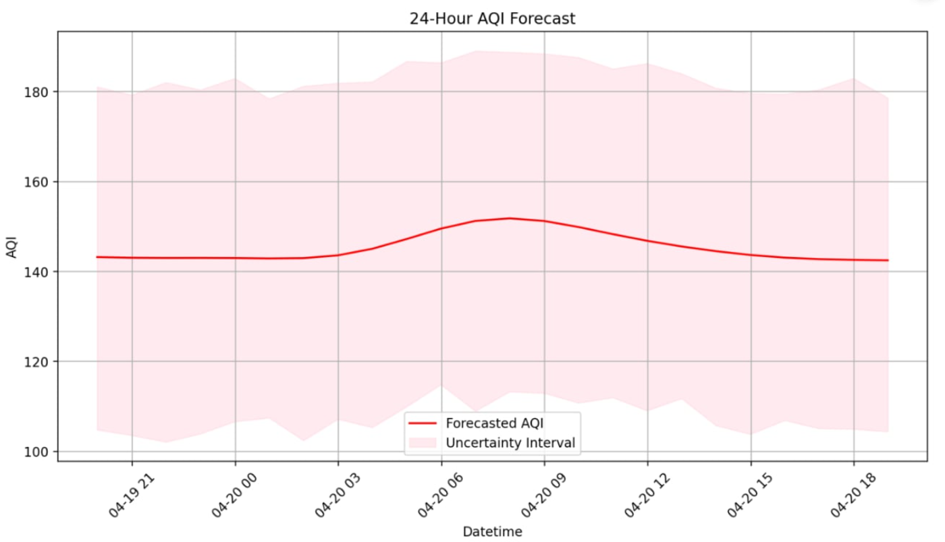
Forecasting with Facebook Prophet
1
Trend
Identifies the overall long-term direction of AQI levels.
2
Seasonality
Captures recurring patterns in AQI levels, such as seasonal variations or daily fluctuations.
3
Hourly & Weekly
Forecasts for hourly and weekly estimated AQI.

Slide 6
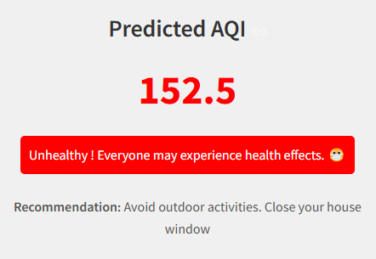


Real-Time AQI Prediction
Input Data
Prediction Output
Users can input current environmental parameters, such as PM2.5, temperature, and humidity.
The dashboard predicts the corresponding AQI using a pre-trained Random Forest Regressor.

Slide 7
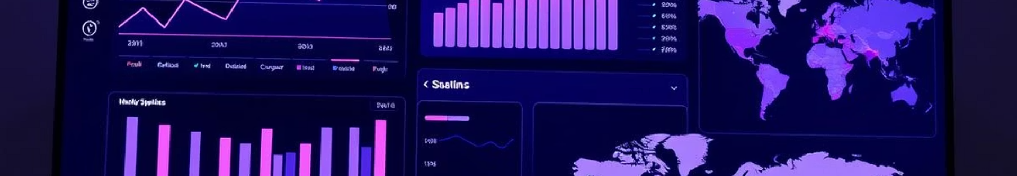
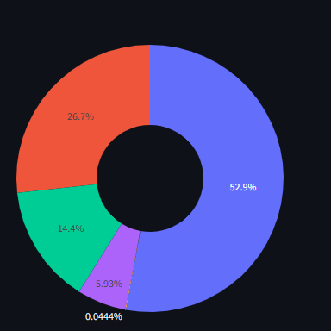




Interactive Dashboard Features
Visualize
Explore historical AQI trends, view correlation heatmaps, pie charts, and monthly averages.
Predict
Input environmental data to predict AQI based on real-time conditions.
Forecast
Use Prophet to forecast AQI for the next 1–3 days, providing insights into future air quality.

Slide 8



Key Findings
Seasonal Variations
1
AQI levels peak during winter months, with several days categorized as Very Unhealthy.
Traffic Impact
2
Daily AQI variations show a rise in the early morning and evening, coinciding with peak traffic hours.
Pollutant Correlations
3
Strong relationships were observed between AQI and gases like CO and NO₂.

Slide 9
Recommendations
Public Awareness
1
Educate citizens about air pollution risks and encourage responsible behaviors, such as reducing vehicle use and promoting sustainable practices.
Policy Interventions
2
Implement stricter emission standards for vehicles and industries, promote public transportation, and encourage the use of renewable energy sources.
Continuous Monitoring
3
Expand air quality monitoring networks, invest in advanced sensor technologies, and leverage data science for real-time monitoring and forecasting.

Slide 10

Next Steps
This project serves as a foundation for future advancements in air quality management in Kathmandu. By integrating real-time sensor data, expanding the scope of pollutants, and exploring more advanced forecasting models, we can further improve air quality predictions and contribute to a healthier environment for all.

